Slide 1
Exemplar Evaluation
B324
Production Portfolio

Slide 2
Influences and Inspirations
While making a teen drama we were very aware
that we wanted to create suspense and tension
in our early scenes involving a teen being bullied
and victimised by his peers.
For this reason we found that we were heavily
influenced by the thriller genre (which relies on
suspense). We were particularly impressed by
the Peter Weir film, ‘Witness’ and the Peter Yates
Film, ‘Mercury Rising.’

Slide 3
Influence of Witness
We analysed a particular scene and found these
conventions which we attempted to emulate.
Screentime is
given to the victim to create audience identification
Crosscutting between our protagonist hiding and antagonist creates suspense

Slide 4
Influences of Mercury Rising

Slide 5
Conventions : Representations
Antagonists
Protagonists
Low angled shots make our antagonists menacing
We cast larger, more stocky actors to increase their sense of threat.

Slide 6
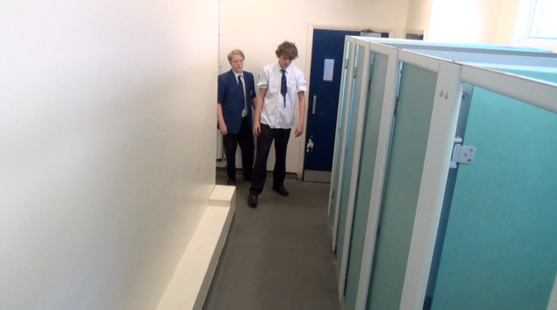
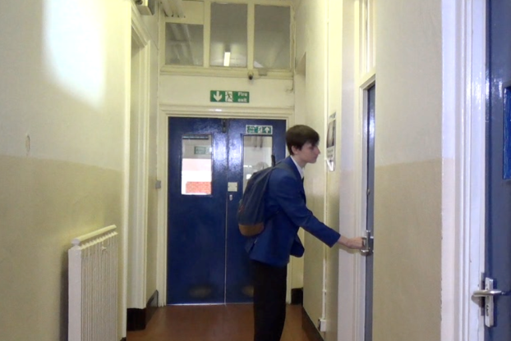
Editing and Camerawork Conventions
The two shots highlight that they are a team
Crosscutting between antagonists and protagonists creates suspense
The high angled shot makes the protagonist more vulnerable

Slide 7
Post Production (Titles/Sound/Effects)

Slide 8
Audience Feedback
We showed a rough cut of out film to an
audience and were initially disappointed with
the reaction. The suspense and tension that we
had hoped for was not apparent. We decided to
reshoot and include more crosscutting which
solved this problem.
(see questionnaires in appendix)

Slide 9
Contribution
I was involved in all stages of production.
Pre-Production
I scripted/ co-wrote storyboards (see appendix), wrote a pitch (see appendix) and carried out a recce report
Production
I was cameraman. I was instrumental in setting up shots, used tracking and the tripod as well as deciding on
framing and reshooting.
Post Production
I collected data from our target audience co-edited the rough cut and will assist with titles and sound in
postproduction.

Slide 10
Difficulties and Challenges
We faced a number of challenges in this, our
first attempt at filming. The main ones were:
Difficulties in lighting interiors leading
Not appreciating the need for fast editing pace

Slide 11
Success of completed version
I feel that our final version is successful in having
created a clear narrative that our audience can
engage with. I am happy with our casting and
costume choices in order to create clear
representations. I also feel that our editing and
camerawork is successful in creating suspense
and feel that we have managed to produce a
satisfying opening scene with a sympathetic
protagonist.

